Slide 1
Timing, Location and Magnitude
Understanding large structural changes across the energy sector and broader economy
Luiza Demoro

Slide 2
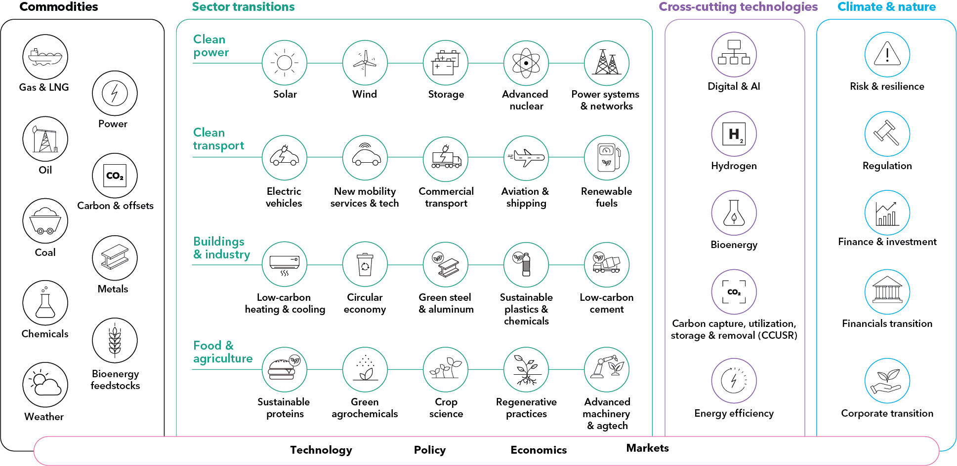
BloombergNEF coverage
Notes:
About BNEF: BloombergNEF is a strategic research provider covering global commodity markets and the disruptive technologies shaping the future of the energy system

Slide 3
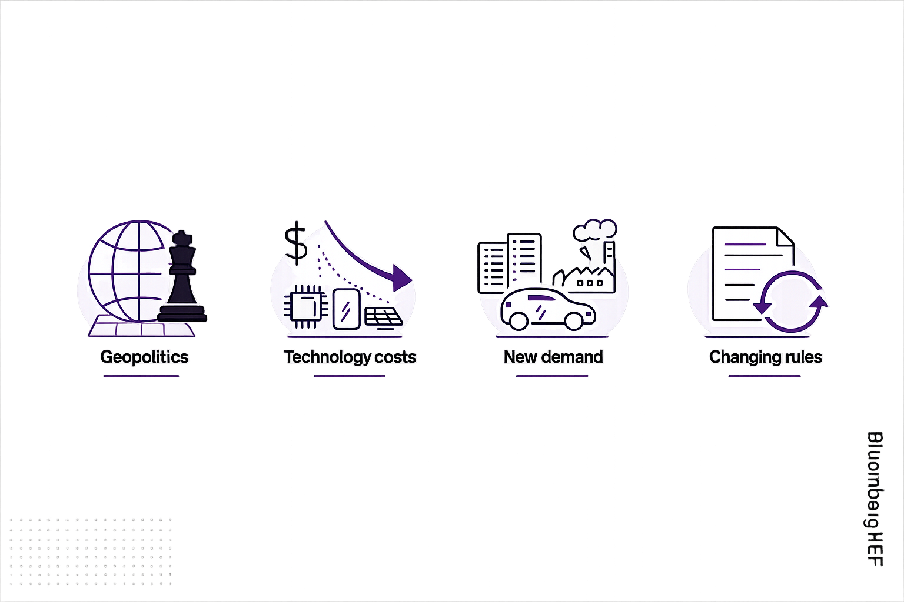
The world is getting more complex
Energy is at the center of geopolitics

Slide 4
The world is getting more complex
Energy is at the center of geopolitics
Technology costs are moving quickly

Slide 5
The world is getting more complex
Energy is at the center of geopolitics
Technology costs are moving quickly
New sources of demand are appearing fast

Slide 6
The world is getting more complex
Energy is at the center of geopolitics
Technology costs are moving quickly
New sources of demand are appearing fast
Long-term decisions amid unstable rules

Slide 7

Timing, location and magnitude

Slide 8

Timing, location and magnitude
What do these changes mean for my strategy, risk and opportunities?

Slide 9
BNEF’s New Energy Outlook (NEO) scenarios
BNEF’s collective, data-driven view of credible pathways for the energy economy over the next decade and beyond

Slide 10
BNEF’s New Energy Outlook (NEO) scenarios
BNEF’s collective, data-driven view of credible pathways for the energy economy over the next decade and beyond
Economic Transition Scenario (ETS)
Exploratory base case that describes how the power, industry, transport and buildings sectors might evolve as a result of cost-based technology changes.
Consistent with a global warming outcome of 2.4C by 2100.
Accounts for firm near-term policies but assumes no further support beyond existing measures.
The low-carbon transition is largely limited to the power and transport sectors.

Slide 11
BNEF’s New Energy Outlook (NEO) scenarios
BNEF’s collective, data-driven view of credible pathways for the energy economy over the next decade and beyond
Economic Transition Scenario (ETS)
Net Zero Scenario (NZS)
Exploratory base case that describes how the power, industry, transport and buildings sectors might evolve as a result of cost-based technology changes.
Consistent with a global warming outcome of 2.4C by 2100.
Accounts for firm near-term policies but assumes no further support beyond existing measures.
The low-carbon transition is largely limited to the power and transport sectors.
Normative climate scenario outlining a credible maximum-effort pathway to limit warming to well below 2C using existing technologies.
Consistent with peak warming of 1.81C by 2049 and 1.73C by 2100.
Delivers net zero across power, transport, industry and buildings sectors by 2050 under defined sectoral carbon budgets.
Includes limited overshoot and moderate post-2050 carbon removals.

Slide 12
BNEF’s New Energy Outlook (NEO) scenarios
BNEF’s collective, data-driven view of credible pathways for the energy economy over the next decade and beyond
Economic Transition Scenario (ETS)
Net Zero Scenario (NZS)
Exploratory base case that describes how the power, industry, transport and buildings sectors might evolve as a result of cost-based technology changes.
Consistent with a global warming outcome of 2.4C by 2100.
Accounts for firm near-term policies but assumes no further support beyond existing measures.
The low-carbon transition is largely limited to the power and transport sectors.
Normative climate scenario outlining a credible maximum-effort pathway to limit warming to well below 2C using existing technologies.
Consistent with peak warming of 1.81C by 2049 and 1.73C by 2100.
Delivers net zero across power, transport, industry and buildings sectors by 2050 under defined sectoral carbon budgets.
Includes limited overshoot and moderate post-2050 carbon removals.
Notes:
Today, I will focus mostly on the Economic Transition Scenario.
This scenario helps us understand where the system moves on economics alone and then allows us to discuss what additional measures would be needed to achieve other outcomes.
I will start with the sub-sectoral shifts in power, transport and grids. These are the areas where the transition is already most visible, and where most of the capital is flowing.
Then I will step back and show what these changes mean at a higher level.

Slide 13
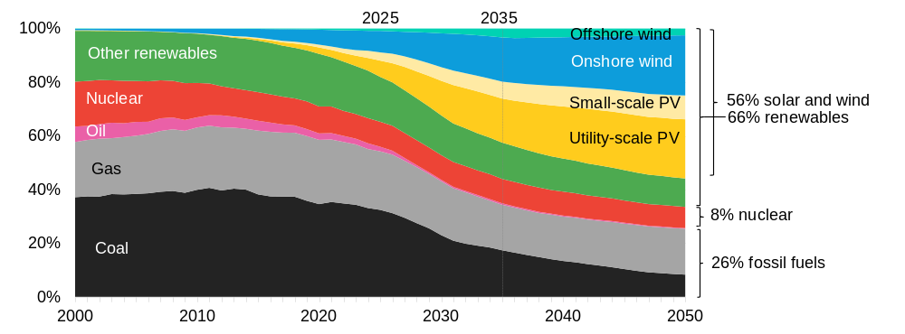
Power systems go through a massive transformation in the coming decade
Global electricity generation by technology, Economic Transition Scenario (ETS)
Source: BloombergNEF. Note: “Other renewables” includes hydro, bioenergy, geothermal, and marine technologies.

Slide 14
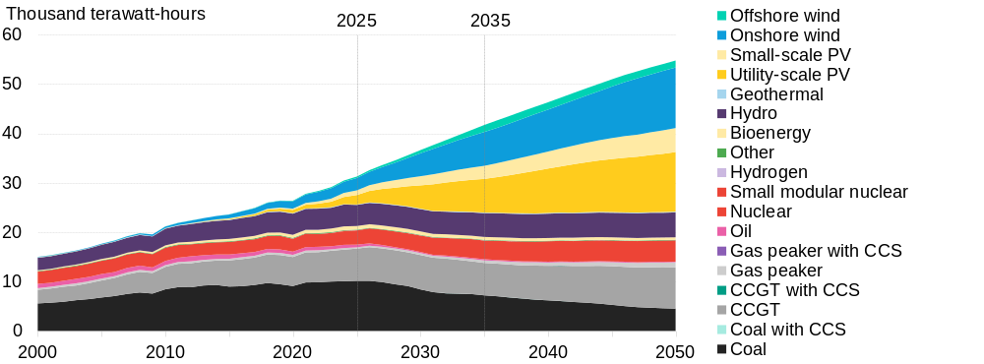
Renewable generation more than doubles over the next decade under ETS
Electricity generation by technology, Economic Transition Scenario
2x renewables
Source: BloombergNEF. Note: CCS is carbon capture and storage, CCGT is combined cycle gas turbine. See New Energy Outlook 2026.

Slide 15
The global power system more than triples in size compared to today
Cumulative installed capacity by technology, Economic Transition Scenario
Source: BloombergNEF. Note: “Other renewables’” includes bioenergy, hydro, geothermal

Slide 16
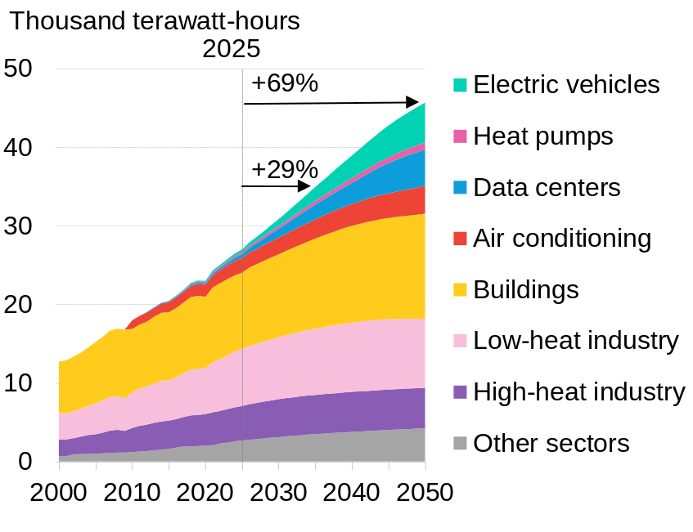
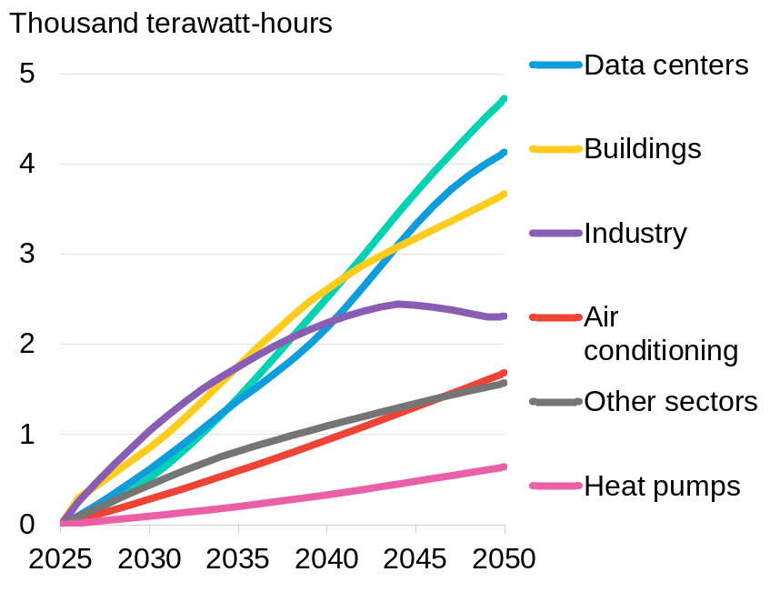
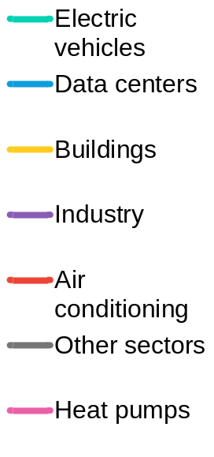
Global power demand rises almost 70% by 2050
Global final power demand by sector, ETS
Growth in power demand by source from 2025, ETS
11%
10%
BloombergNEF. Note: “Other sectors” includes agriculture and sectors not further defined

Slide 17
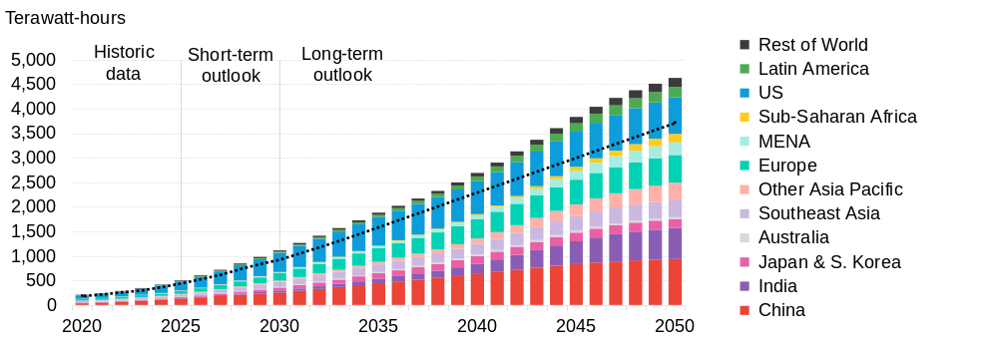
Power demand from data centers has supercharged a race to build infrastructure
Global data center power demand by market, 2020-2025
Source: BloombergNEF, DC Byte. Note: “ETS 2025” is Economic Transition Scenario. The data-center demand outlook is the same in both scenarios. To estimate power demand, BNEF uses a short-term bottom-up outlook based on an asset-level pipeline and a long-term, top-down forecastbased on consumer demand and uptake for data center services.

Slide 18
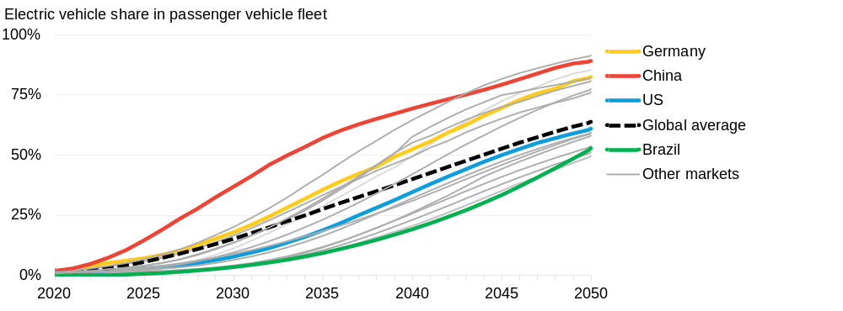
The share of EVs in total passenger fleet grows rapidly
Share of electric vehicles in total passenger fleet, Economic TransitionScenario
Total global:
2025: 6%
2034: 25%
2050: 64%
Source: BloombergNEF. Note: ”Other markets” includes 16 markets and regions.

Slide 19
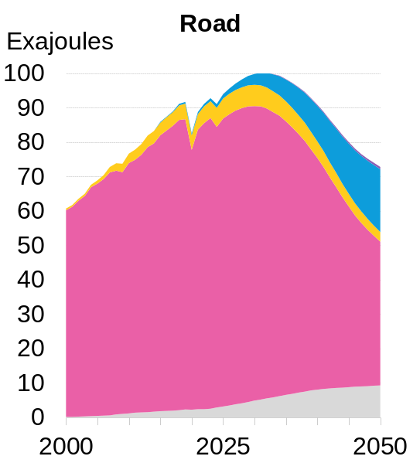
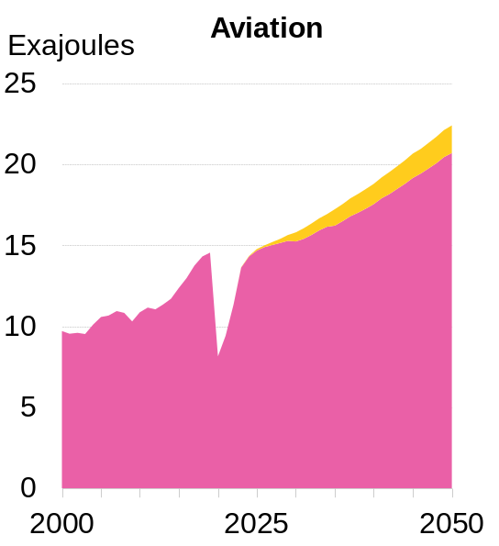
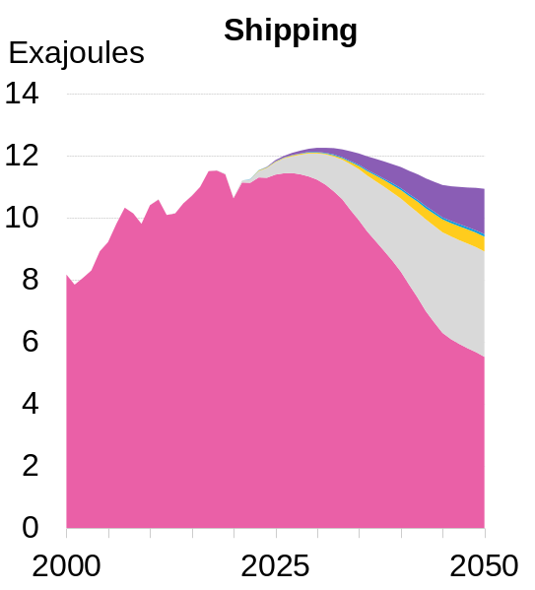
The rise of EVs lead to road sector oil consumption to peak in 2029
Final energy consumption by transport sub-sector
Source: BloombergNEF. Note: Y-axes show different scales.

Slide 20
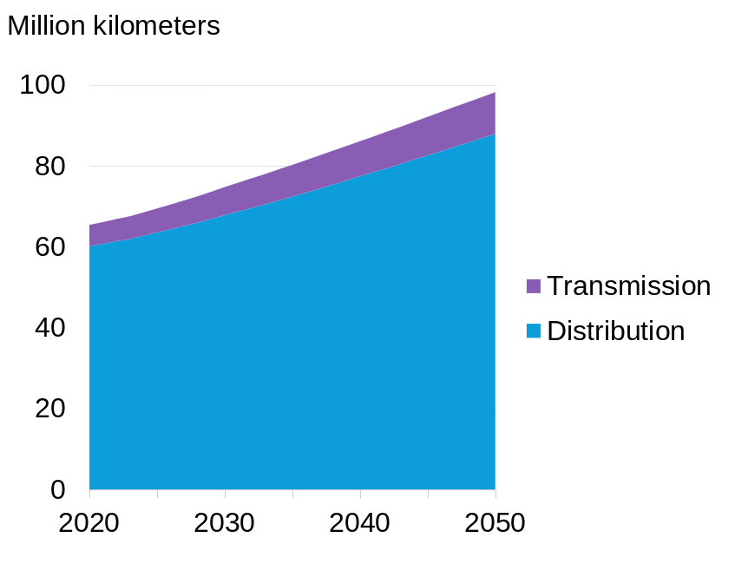
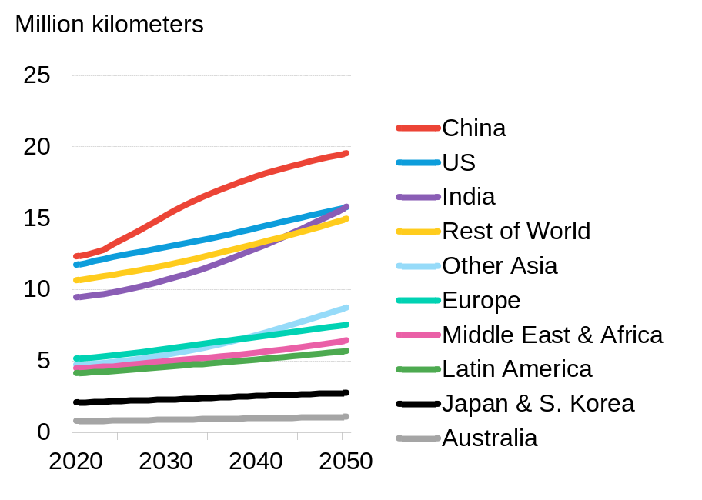
Global grid length grows 41% over the next 25 years
Global grid length by stage, ETS
Grid length by geography, ETS
Source: BloombergNEF

Slide 21
High-level findings
What the sectoral changes mean for global energy dynamics

Slide 22
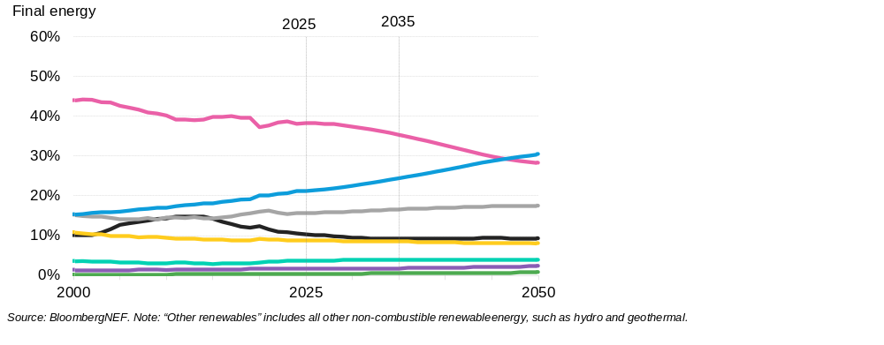
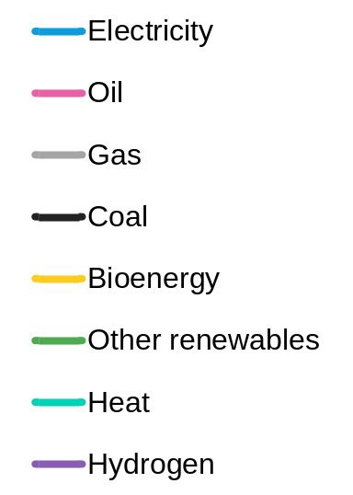
Electricity becomes the dominant source of final energy by 2047
Global final energy consumption by fuel and scenario, ETS
Source: BloombergNEF. Note: “Other renewables” includes all other non-combustible renewable energy, such as hydro and geothermal.

Slide 23
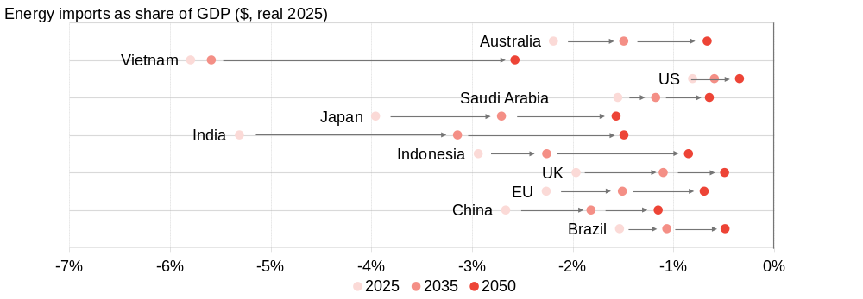
New energy technologies improve energy security
Energy commodity import dependence for selected markets, 2025-2035-2050
Source: BloombergNEF Trade Transition Scenario Tool, Sinoimex Global Trade Flow (GTF), GCAM. Note: Energy commodity imports based on observed 2024 trade data from relevant custom codes for coal, lignite, crude, petroleum oil and gas products, and renewable fuels. Negative values indicate imports. Future imports scaled forward based on domestic demand for related products and services under different scenarios. This projection assumes relative trade patterns remain static and uses the same GDP projections under both scenarios.

Slide 24
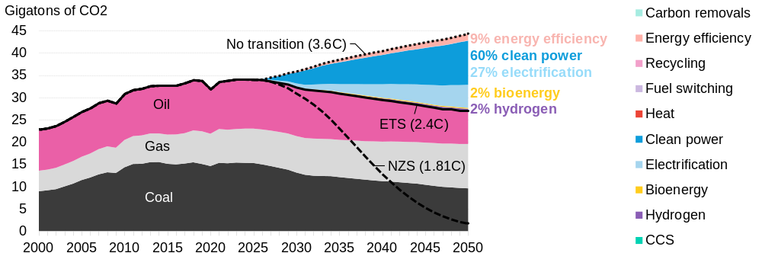
Under ETS, CO2 emissions fall 21% by 2050
CO2 emissions reductions from fuel combustion by measures adopted, by scenario
Source: BloombergNEF. Note: The “no transition” scenario is a hypothetical counterfactual that models no further improvement indecarbonization and energy efficiency. In this scenario, clean tech build for power is capped at historical limits, with costs fixed at2026 levels and no further decline; in buildings and transport, the fuel mix remains unchanged from 2026; in industry, the uptake ofrecycling and alternative primary production processes is limited. “NZS” is the Net Zero Scenario, “ETS” is Economic TransitionScenario.

Slide 25
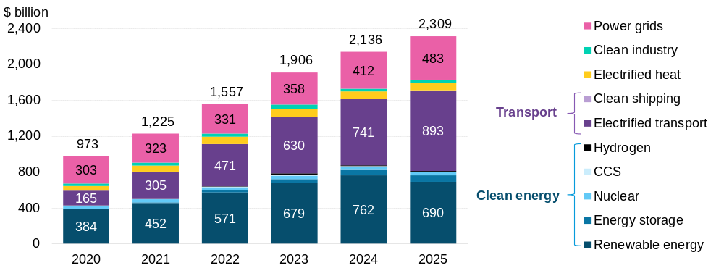
Global energy transition investment hit $2.3 trillion in 2025, a new record
Global energy transition investment, by sector
Source: BloombergNEF. Note: CCS refers to carbon capture and storage.

Slide 26
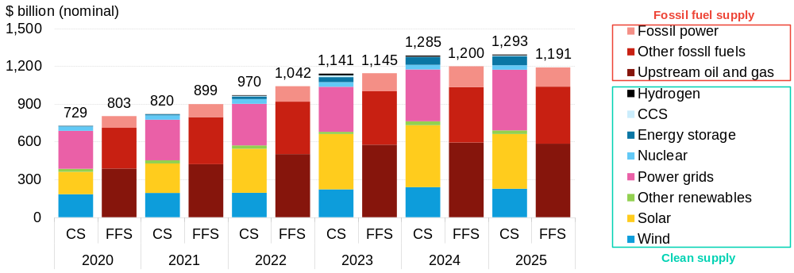
Clean energy supply investment outpaced fossil fuels again
Investment comparison: Clean energy supply vs. fossil fuel supply
Source: BloombergNEF, International Energy Agency (IEA). Note: CS stands for clean supply. CCS stands for carbon capture and storage. Historical volumes for fossil fuel supply (FFS) investment were aggregated from IEA World Energy Investment 2025 (web). Investment includes upstream, midstream, downstream sectors and unabated fossil power generation. Dollar values have been adjusted to nominal terms. Investment in demand for fossil fuels – like gas boilers – is not included.

Slide 27
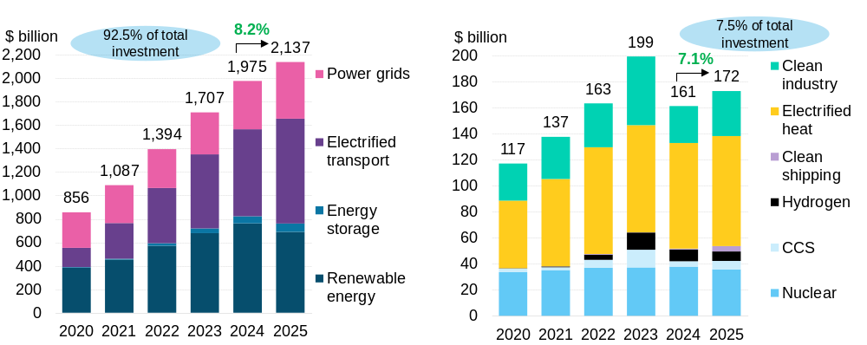
Mature technologies dominate, but emerging areas ticked up in 2025
Energy transition investment trends: mature sectors
Energy transition investment trends: emerging sectors
Source: BloombergNEF. Note: CCS refers to carbon capture and storage.

Slide 28
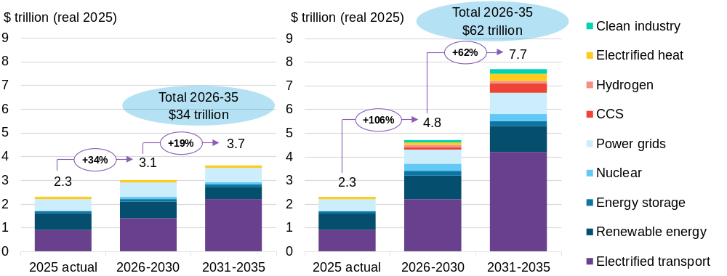
Energy transition investment reaches $34 trillion under ETS over 2026-35
Energy transition investment, 2025 actuals versus required annualized levels in NEO scenarios
Source: BloombergNEF. Note: 2025 actuals are from Energy Transition Investment Trends 2026 (web | terminal). “CCS” is carboncapture and storage

Slide 29
Net Zero requires around 85% more energy-transition investment than the ETS
Energy transition investment, 2025 actuals versus required annualized levels in NEO scenarios
Source: BloombergNEF. Note: 2025 actuals are from Energy Transition Investment Trends 2026 (web | terminal). “CCS” is carboncapture and storage

Slide 30
Timing, location and magnitude
What do these changes mean for my strategy, risk and opportunities?

Slide 31
Copyright and disclaimer

Slide 32
Luiza Demoro

