Slide 1
Por qué hacemos lo que hacemos

Slide 2
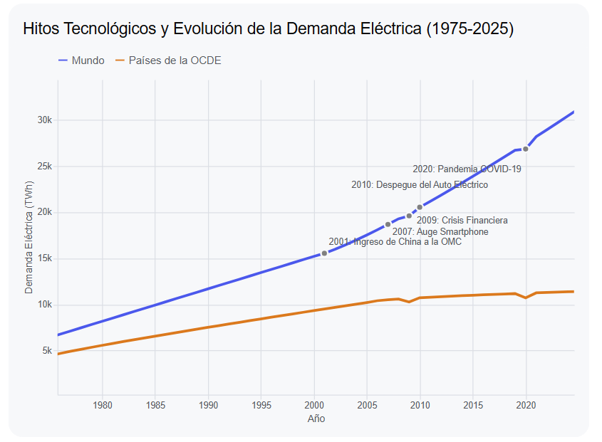
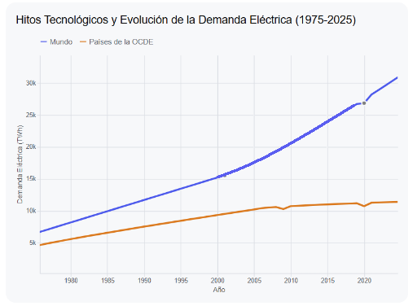
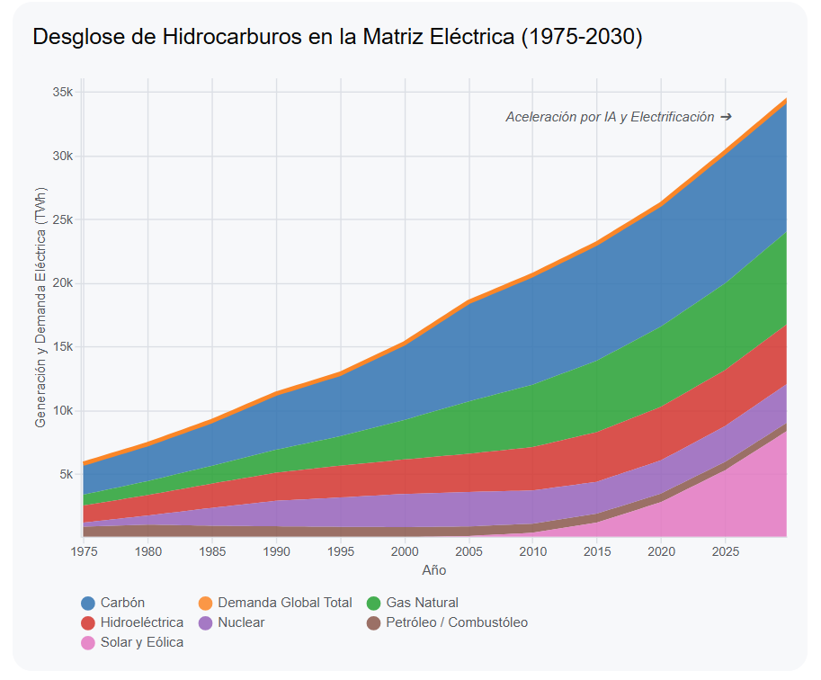
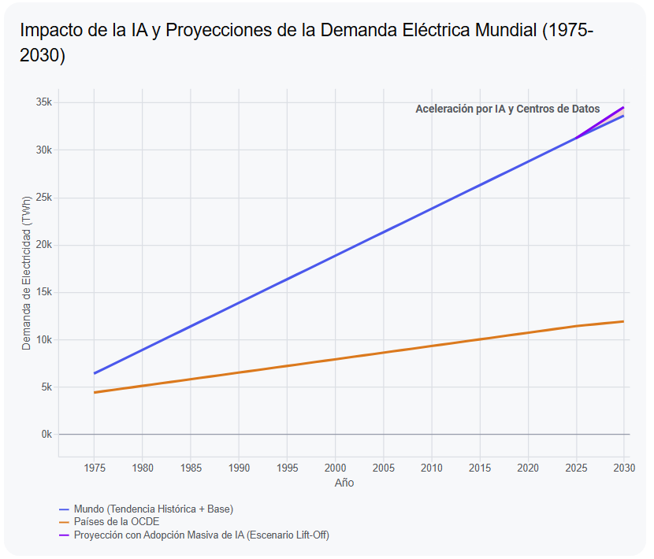
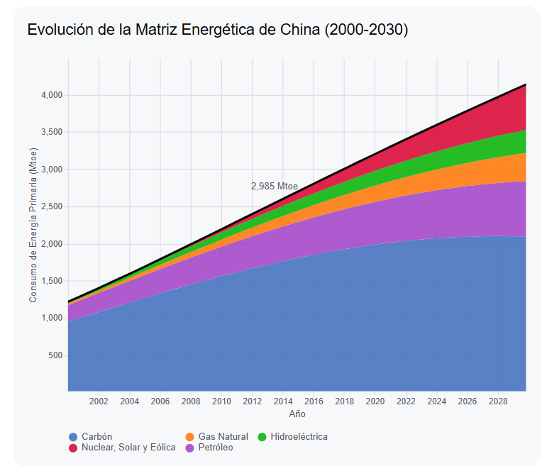
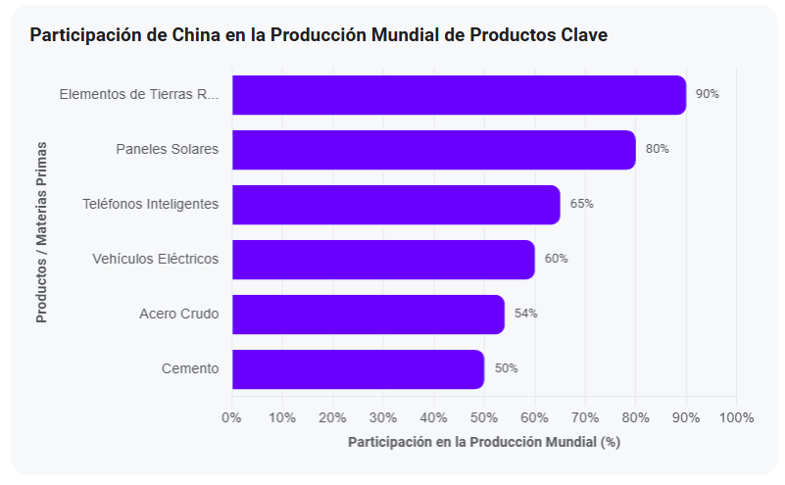

Slide 3
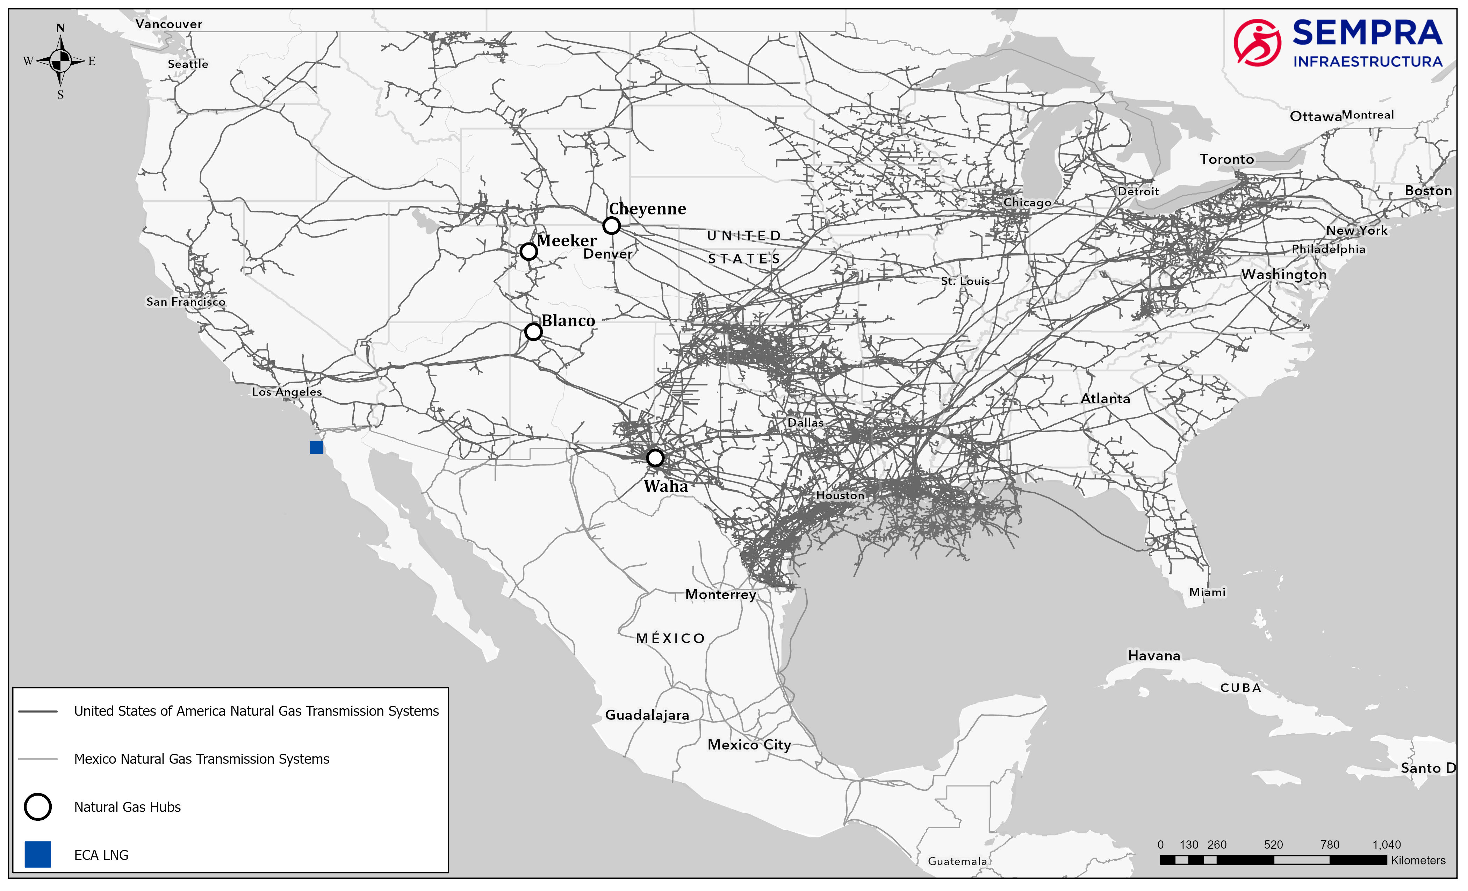
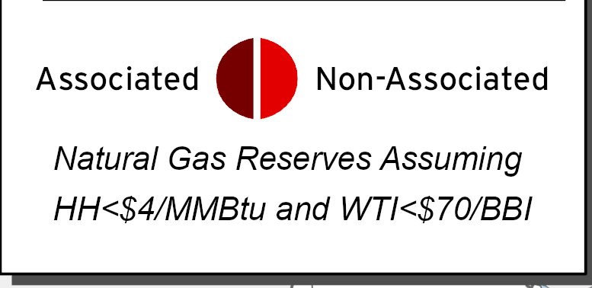
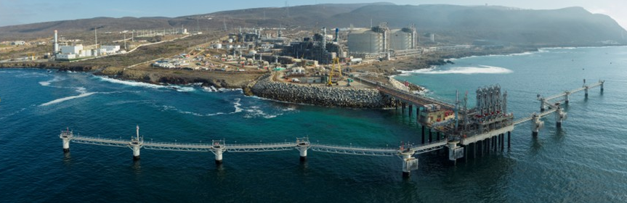
Bakken
23 Tcf
WCSB 358 Tcf
Rockies
56 Tcf
Marcellus / Utica 443 Tcf
San Juan
8 Tcf
Anadarko
40 Tcf
Haynesville 320 Tcf
Fort Worth 10 Tcf
Haynesville 320 Tcf
Permian 464 Tcf
W. Haynesville 18 Tcf
Permian 464 Tcf
To Asian Markets via ECA: ~13 days
To Asian Markets via Suez Canal: ~38 days
Mexico
Eagle Ford 98 Tcf
Mexico
Mexico
To Asian Markets via Panama Canal: ~25 days
Source: S&P Global

